Slide 1
Telecom Churn Case Study

Slide 2
Overview
Identify Problem Statements.
Data Collection
Exploratory Data Analysis
Feature Engineering
Feature Selection
Handling Imbalance Data
Model Selection
Create and Deploy App

Slide 3
Problem Statement
Predicting customer churn involves identifying factors contributing to attrition.
Analyzing the most profitable service types aids in maximizing revenue.
Understanding churn drivers helps mitigate revenue loss.
Identifying lucrative services allows for targeted marketing strategies.
Quantifying revenue loss guides strategic decision-making for retention efforts.

Slide 4
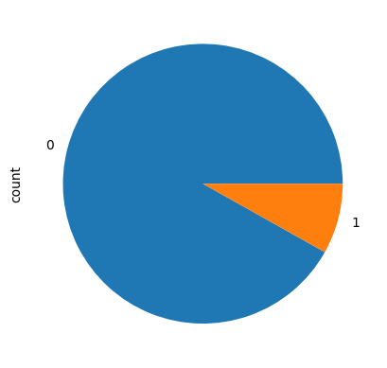
Noticing that 91% of customers remain subscribed suggests a potential imbalance in class distribution, warranting attention to class proportions in the dataset.

Slide 5
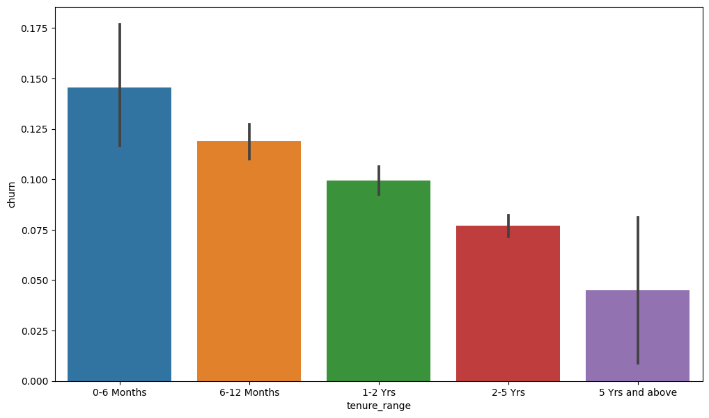
- The bar plot illustrates that the highest rate of churn is observed during the initial 0-6 month period.
- Churn rates gradually decline as customers continue their association with the network.
- Over time, customers tend to stabilize their usage patterns and exhibit reduced likelihood of churn.
- The data indicates a trend of decreasing churn as customer tenure with the network increases.
- There is a notable decline in churn rates among customers who have been with the network for longer durations.

Slide 6
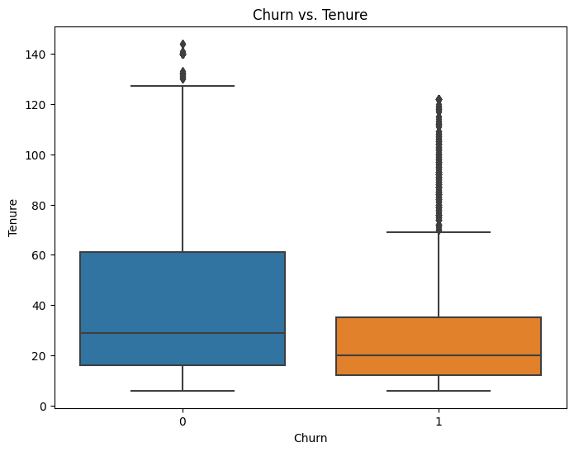
- The box plot demonstrates a correlation between customer tenure and churn rates.
- Customers with extended tenure exhibit reduced likelihood of churn, suggesting higher retention rates.
- Longer-tenured customers are more inclined to maintain their subscription to telecom services.
- There is an observable trend indicating that as tenure increases, churn rates decrease.
- The data highlights a relationship between customer loyalty, tenure, and propensity to churn.
- Higher churn rates are observed among customers with shorter tenures, emphasizing the importance of retaining long-term subscribers.

Slide 7
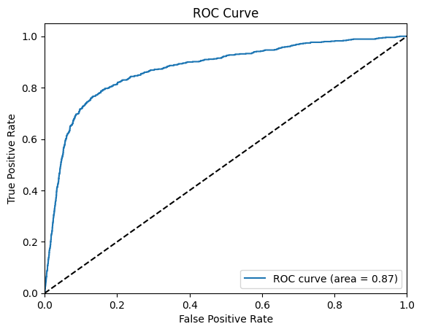
The AUC score for the training dataset is 0.90, while for the testing dataset it stands at 0.87.
These scores suggest effective performance of the model in both training and testing phases.
AUC scores of 0.90 and 0.87 indicate strong predictive capability of the model.
The model exhibits good discriminatory power in distinguishing between classes.
High AUC scores of 0.90 and 0.87 validate the model's effectiveness in classification tasks.
These results demonstrate robust performance of the model across different datasets, indicating its reliability in predicting outcomes.

Slide 8
The logistic regression model with PCA achieves an accuracy of 0.7566937006999223.
This accuracy score reflects the performance of the model in correctly classifying instances.
The logistic regression model, coupled with PCA, demonstrates a satisfactory level of predictive accuracy.
With an accuracy of 0.7566937006999223, the model effectively captures patterns in the data.
The achieved accuracy indicates the model's ability to make accurate predictions.
The logistic regression model, enhanced by PCA, achieves a notable level of accuracy.
This accuracy score showcases the model's capability to classify data points accurately.
With an accuracy score of 0.7566937006999223, the model performs well in its classification task.
The logistic regression model, when combined with PCA, yields satisfactory predictive accuracy.
The achieved accuracy score demonstrates the effectiveness of the logistic regression model in making accurate predictions, further enhanced by PCA.

